Slide 1

Stage 6 Hey Stranger Course Designer: Xuzi Zhou
Hey Stranger is a 8 round, 40 point COMSTOCK SHORT course. There are 3 USPSA targets and 2 steel targets. The best two hits per target will score. Steel must fall to score. The start signal is audible.
The Handgun start position is standing in the shooting area with wrists below belt. Handgun loaded and holstered. The PCC start position is standing in the shooting area with safety on, stock on belt, muzzle pointing downrange.
On the audible start signal, engage all targets from within the shooting area. P1 activates T1 & T2, P2 activates T3. All remain visible at rest.

Slide 2
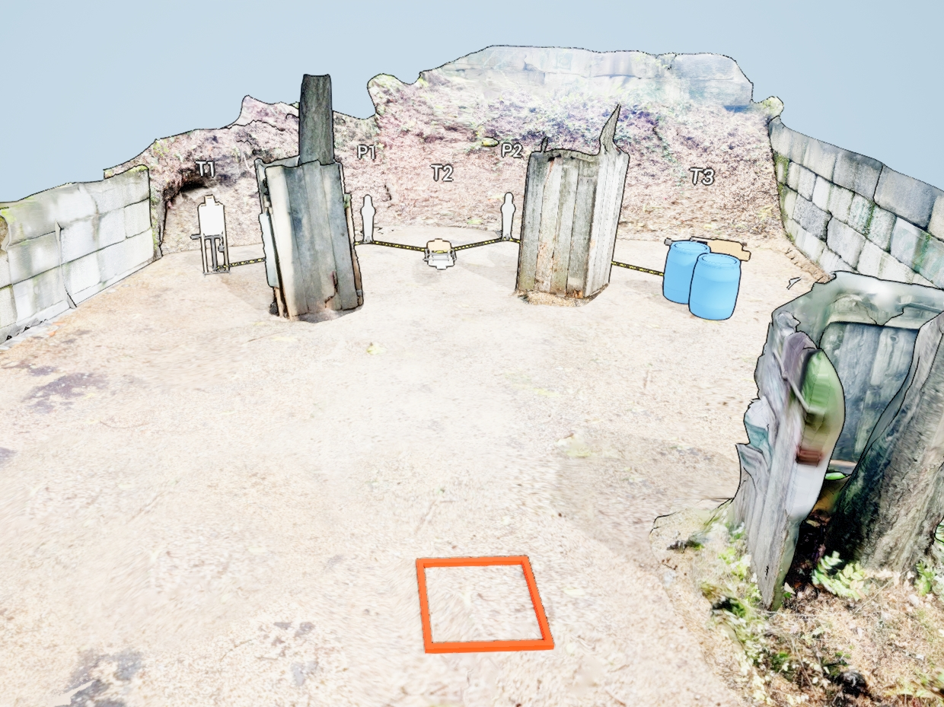
 | Stage 6 Hey Stranger Course Designer: Xuzi Zhou

